Slide 1
thesis plots
2019-2021
Jie Hu

Slide 2
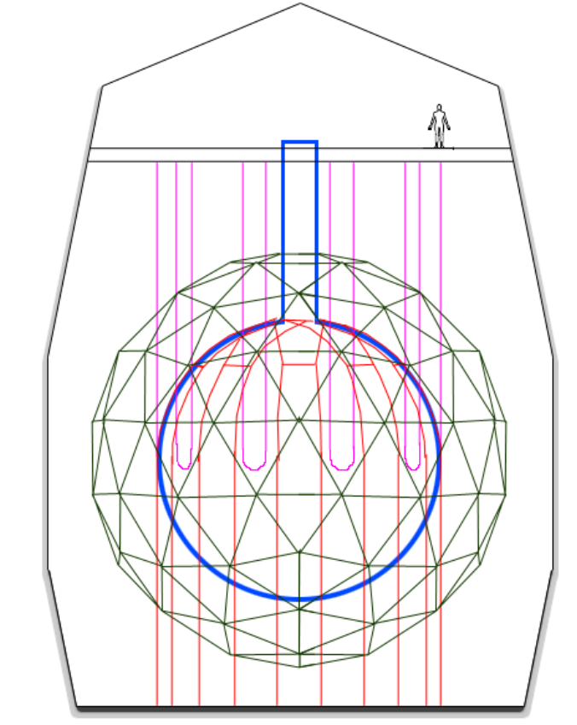
Deck
Neck
Hold-up ropes
PMT support structure
Rock cavity
Acrylic vessel
Hold-down ropes

Slide 3
pp
pep
p + p → ²H + e⁺ + ν_{e}
p + e⁻ + p → ²H + ν_{e}
99.76%
0.24%
²H + p → ³He + γ
84.6%
15.4%
2.5x10⁻⁵%
hep
³He + ³He → ⁴He + 2p
³He + ⁴He → ⁷Be + γ
³He + p → ⁴He + e⁺ + ν_{e}
pp-I
99.89%
⁷Be
0.11%
⁷Be + e⁻ → ⁷Li + ν_{e}
⁷Be + p → ⁸B + γ
⁸B
⁷Li + p → 2 ⁴He
⁸B → ⁸Be* + e⁺ + ν_{e}
pp-II
pp-III

Slide 4
¹³C
¹³C + p → ¹⁴N + γ
¹⁴N
¹⁷O + p → ¹⁴N + ⁴He
¹⁷O
¹³N → ¹³C + e⁺ + ν_{e}
¹⁴N + p → ¹⁵O + γ
¹⁷F → ¹⁷O + e⁺ + ν_{e}
CN
NO
¹²C + p → ¹³N + γ
¹⁵O→ ¹⁵N + e⁺ + ν_{e}
¹⁶O + p → ¹⁷F + γ
¹²C
¹⁵N + p → ¹²C + ⁴He
¹⁵N
¹⁵N + p → ¹⁶O + γ
¹⁶O
cycle

Slide 5
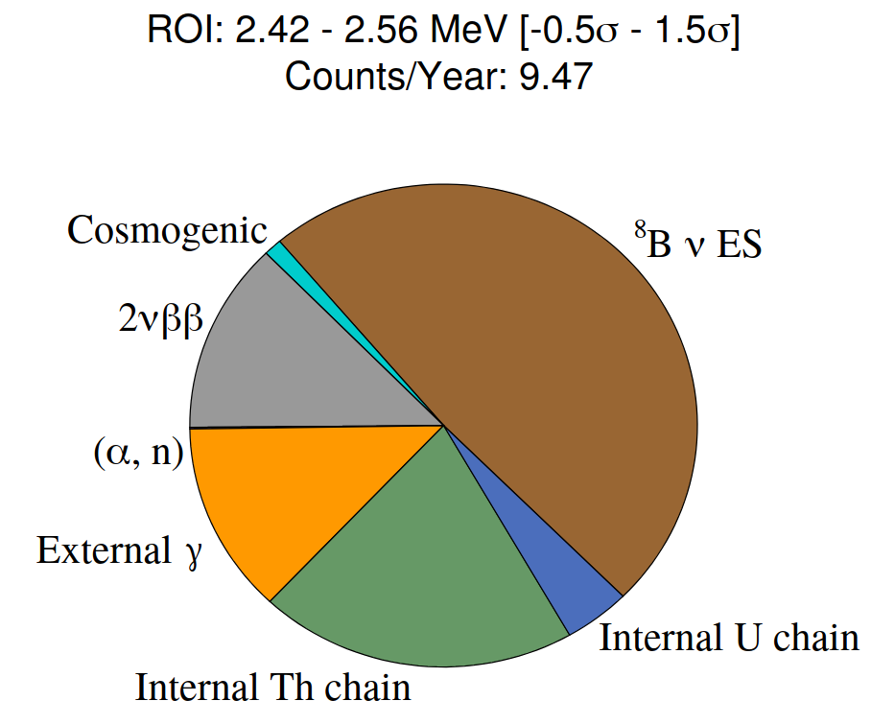
Double Beta Official Plots. Using Te+DDA Optics.
docDB-5681-v3
LAB+PPO+bisMSB+Te(0.5%)+Diol+DDA.

Slide 6
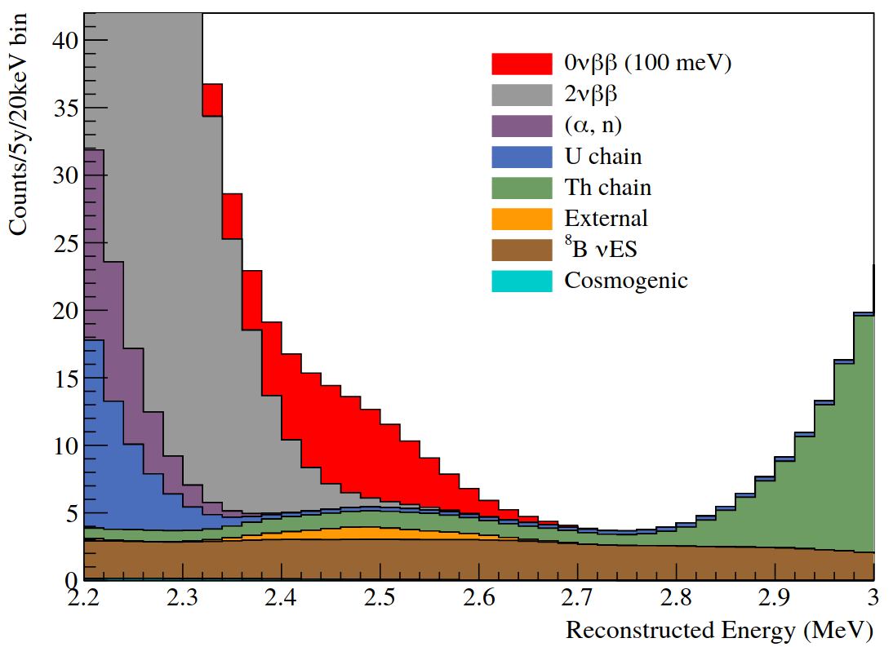

Slide 7
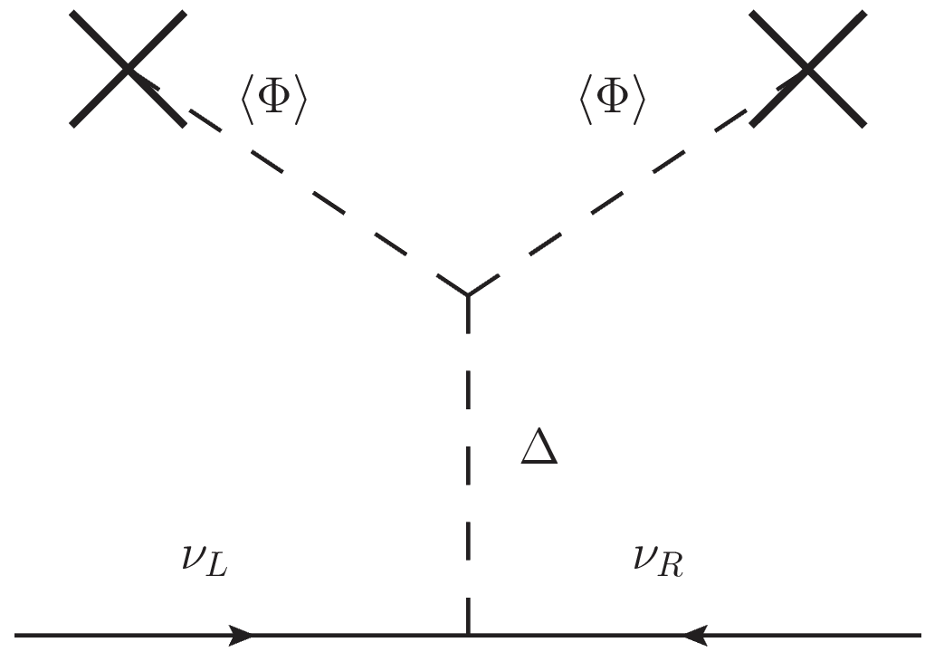
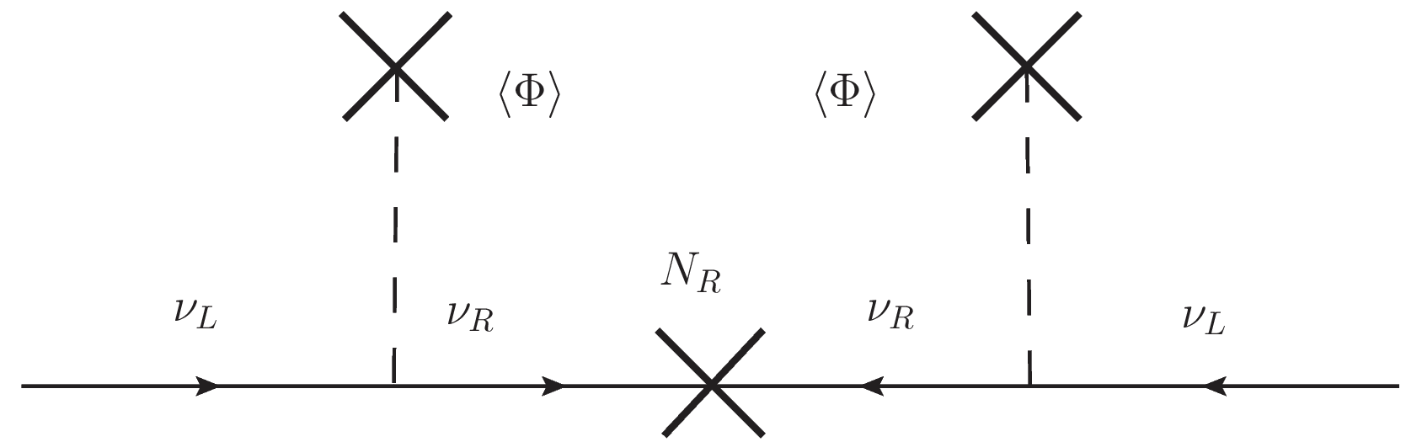

Slide 8
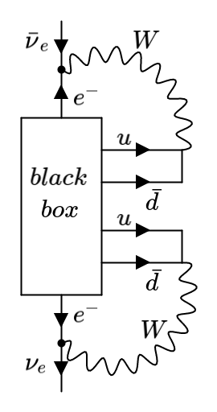
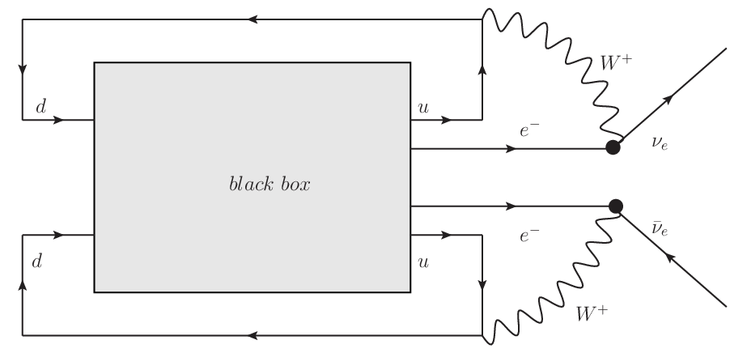

Slide 9
P₁
P
P₂
L
Ω
T₁
PMT sphere
θ
source
offset
O
time of flight
T₂
Ω'
L'
P'₁
P'₂
P'

Slide 10
a₊
PMT
a₊
PMT
ray-tracer
a₋
vertex
(a)
vertex
(b)
a₋
PMT
PMT
vertex
vertex
(c)
(d)

Slide 11
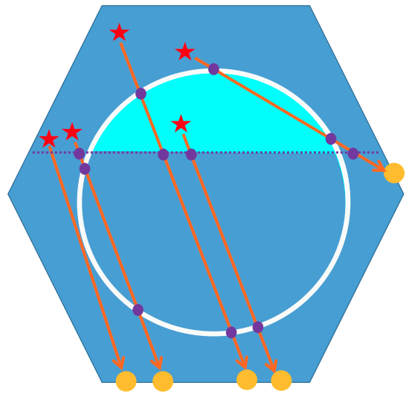
vertex
vertex
vertex

Slide 12

d_{neck}
d_{AV}

Slide 13
PMT
PMT
a₊
vertex
vertex
a₃
vertex
a₃
a₃
a₊
a₊
a₃
a₊
PMT
vertex
(a)
(b)
(c)
(d)
PMT
PMT
PMT
vertex
a₃
z₊
a₊
z₊
a₋
z₋
z₋
a₋
vertex
a₃
a₊
a₊
z₋
a₋
z₊
(e)
(f)
(g)
vertex
PMT

Slide 14
a'₊
a'₊
a₋
a'₊
a₊
a'₋
a₊
a'₊
(a)
(b)
(c)
(d)
a₊
a'₋
a'₊
a'₊
a'₊
a₊
a'₋
a₋
a₋
a'₋
a'₊
a₊
a₊
a'₋
a₋
(e)
(f)
(g)
(h)

Slide 15
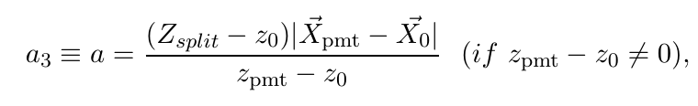
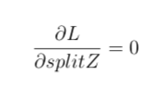
a₃
PMT
vertex
vertex
PMT
vertex
PMT
vertex
PMT

Slide 16
Hough transformation
X_{PMT}
θ_{Ch}
X₀
X₀

Slide 17
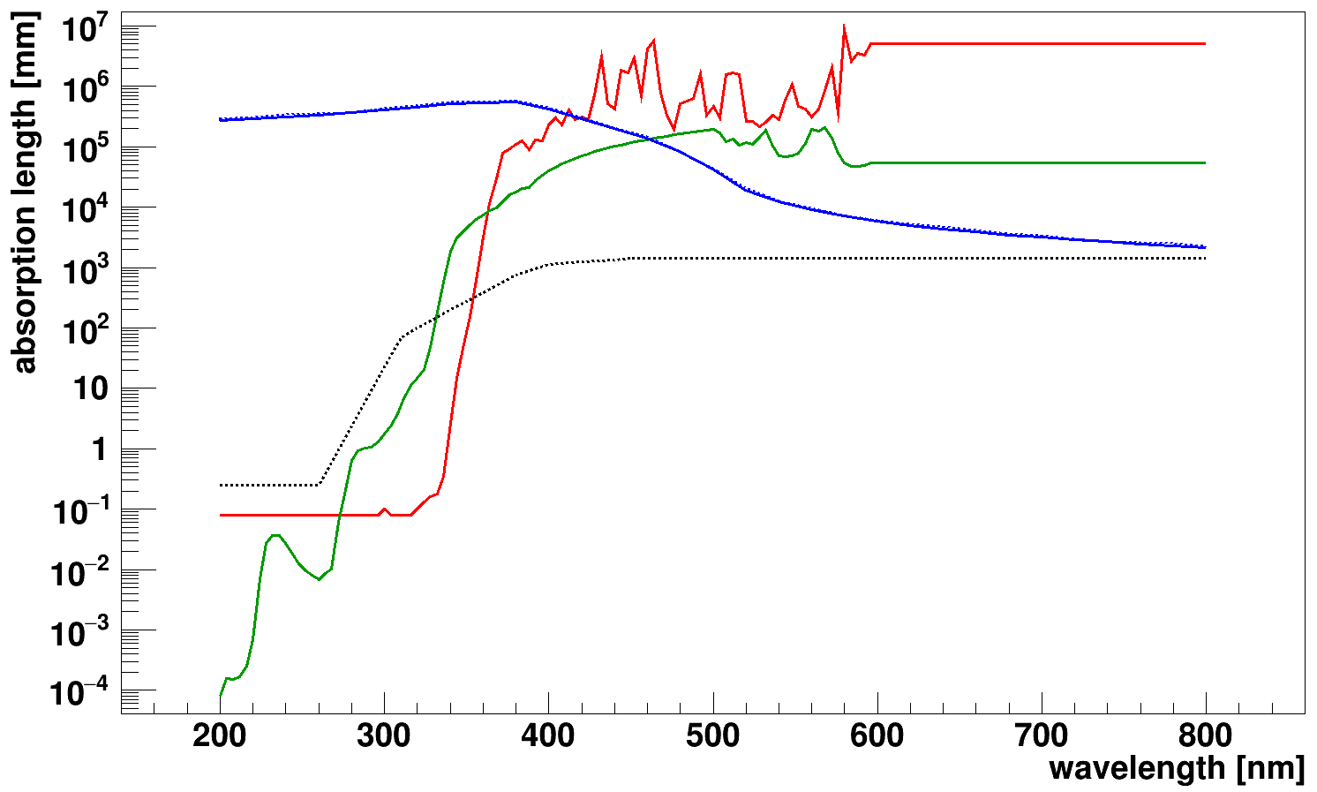
ＬＡＢＰＰＯ
— LAB
— PPO
--- Acrylic
— SNO+ internal water
--- SNO+ external water

Slide 19
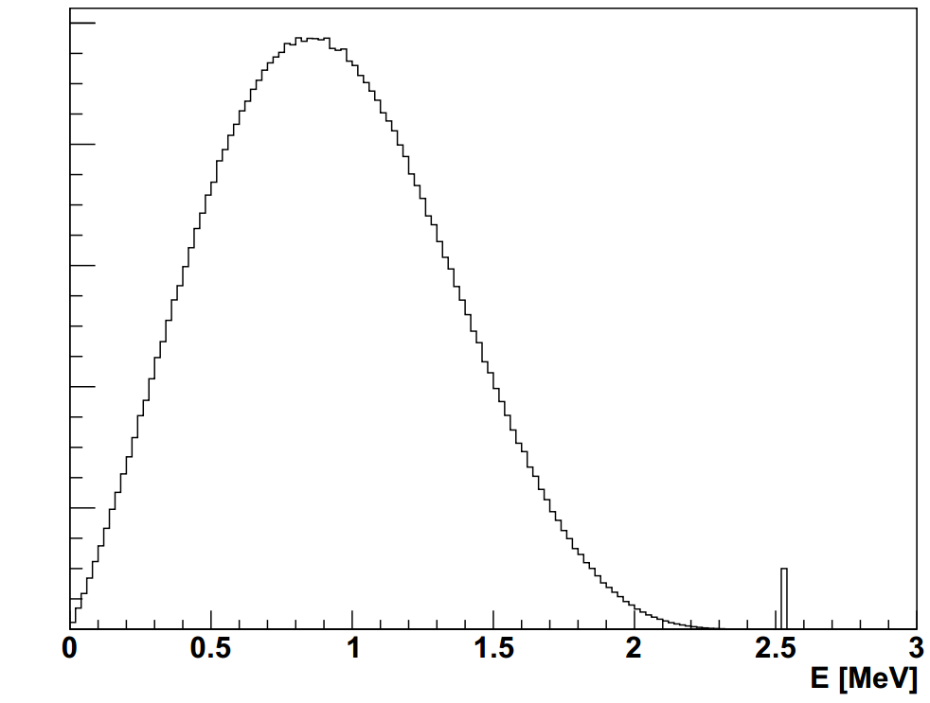
2νββ
counts
0νββ

Slide 20
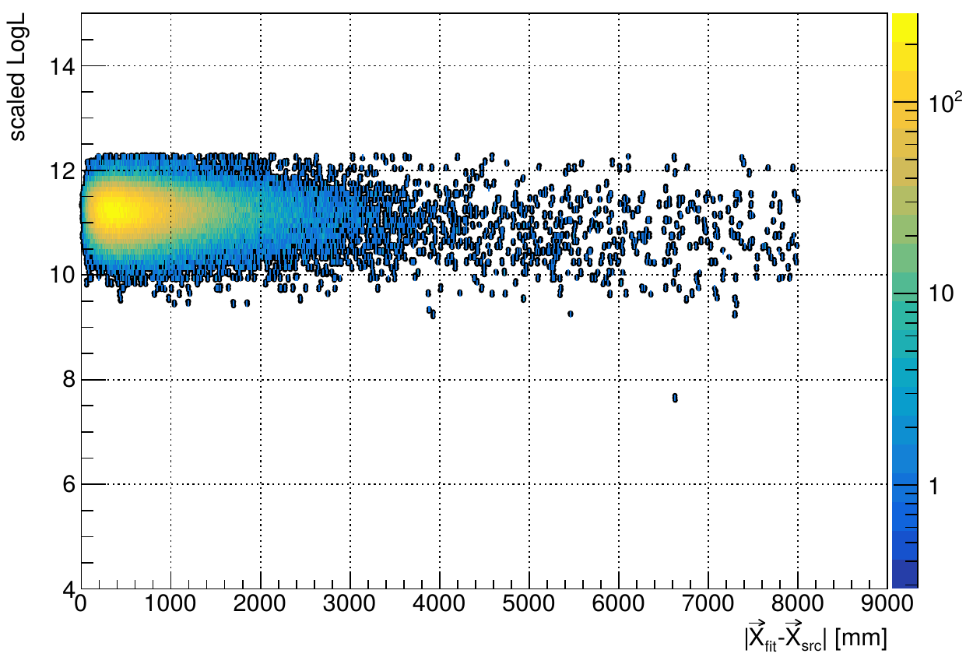
FOM cuts
scaleLogL>10
remove 0.128177%
events
mc

Slide 21
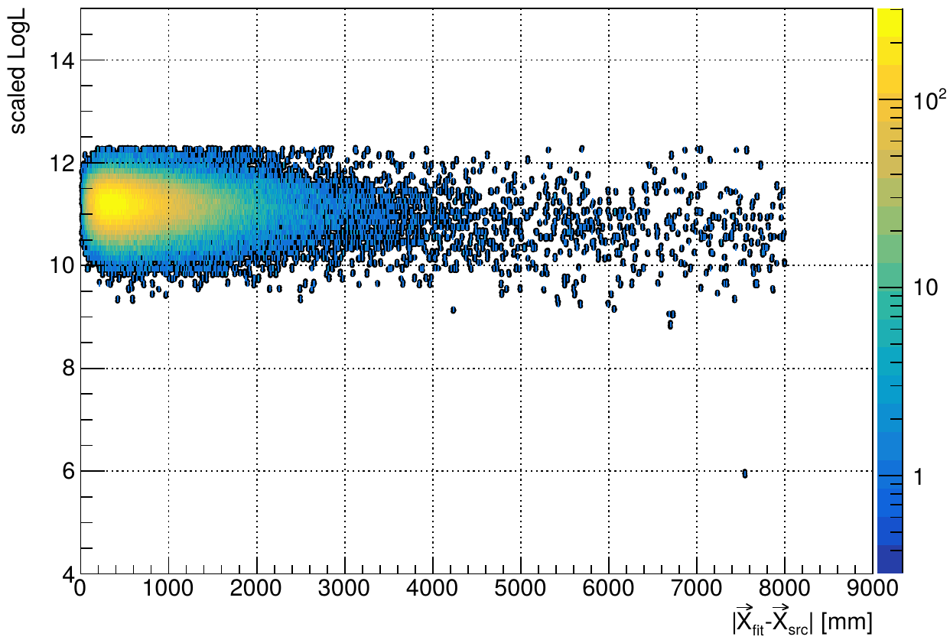
scaleLogL>10
remove 0.179641% events
data

Slide 22
SkyShine

Slide 23
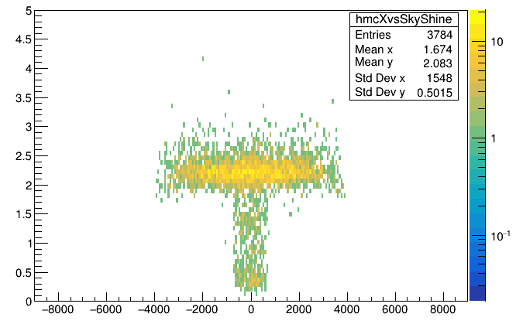
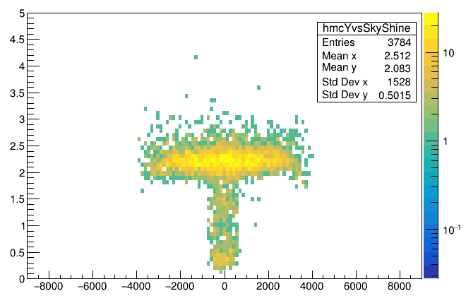
skyShine
x_{mc} [mm]
skyShine
y_{mc} [mm]

Slide 24
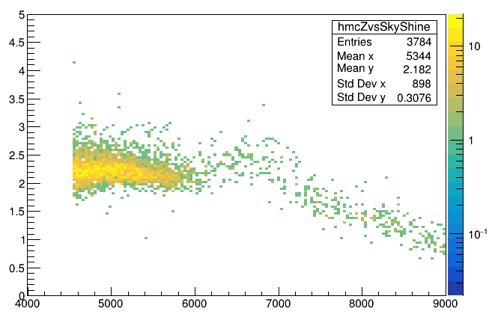
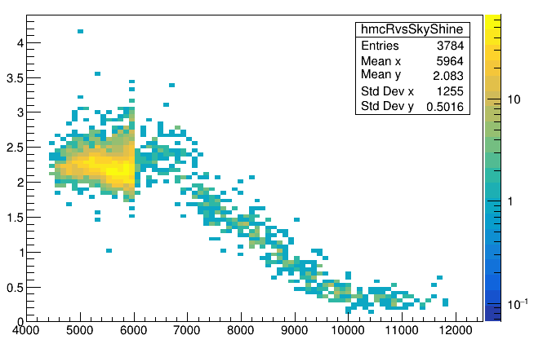
z>=neck
skyShine
skyShine<1.7
z_{mc}-108 [mm]
skyShine
skyShine<1.7
sqrt(x²_{mc}+y²_{mc}+(z_{mc}-108)²) [mm]

Slide 25
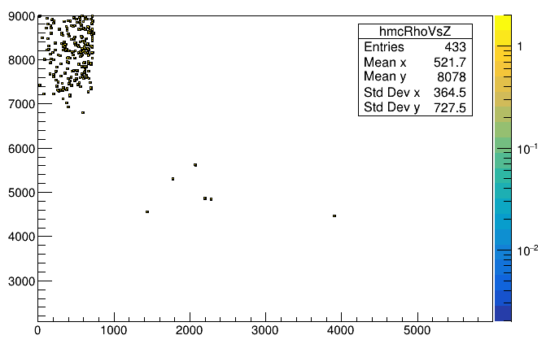
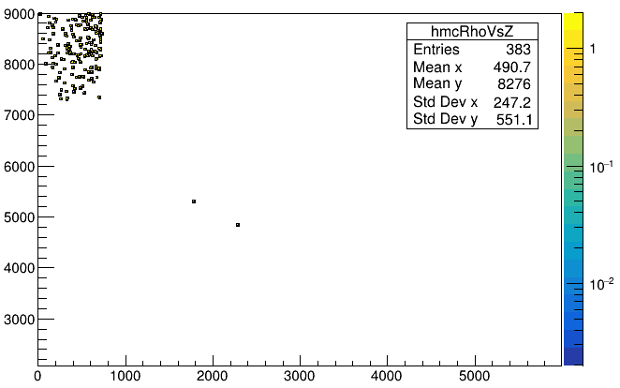
skyShine<1.7
Mostly are high neck region events
z_{mc}-108 [mm]
mis-tagged events
skyShine<1.5
Mostly are high neck region events
sqrt(x²_{mc}+y²_{mc}) [mm]
z_{mc}-108 [mm]
mis-tagged events
sqrt(x²_{mc}+y²_{mc}) [mm]

Slide 26
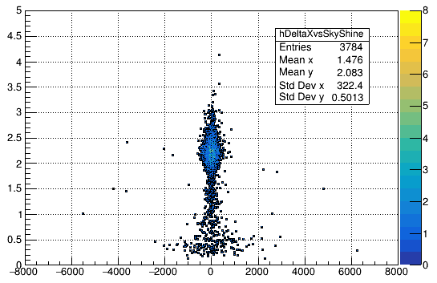
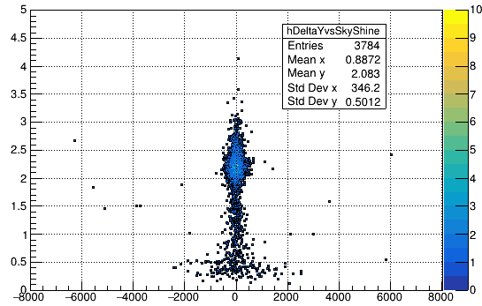
skyShine
skyShine
x_{fit} - x_{mc} [mm]
y_{fit} - y_{mc} [mm]

Slide 27
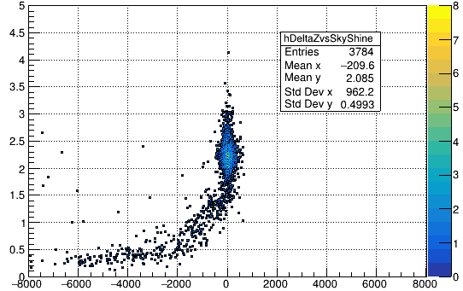
skyShine
z_{fit} - z_{mc} [mm]

Slide 28
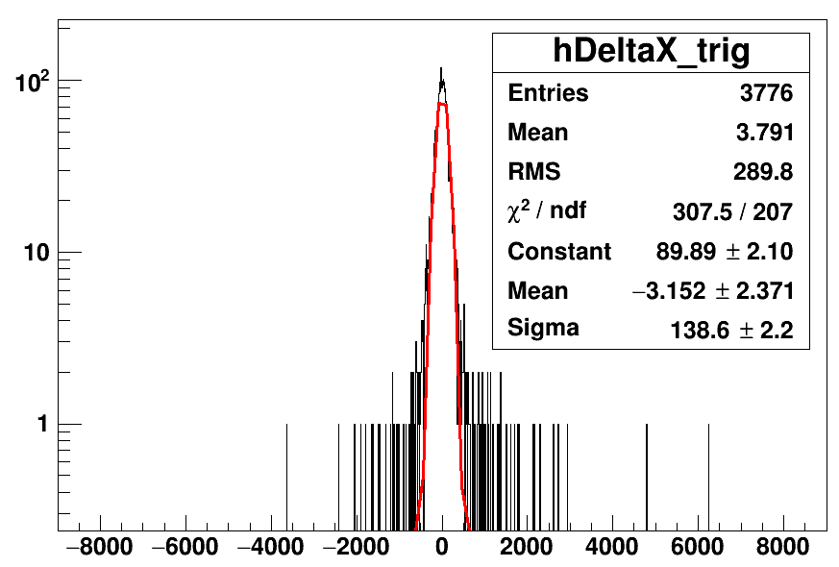
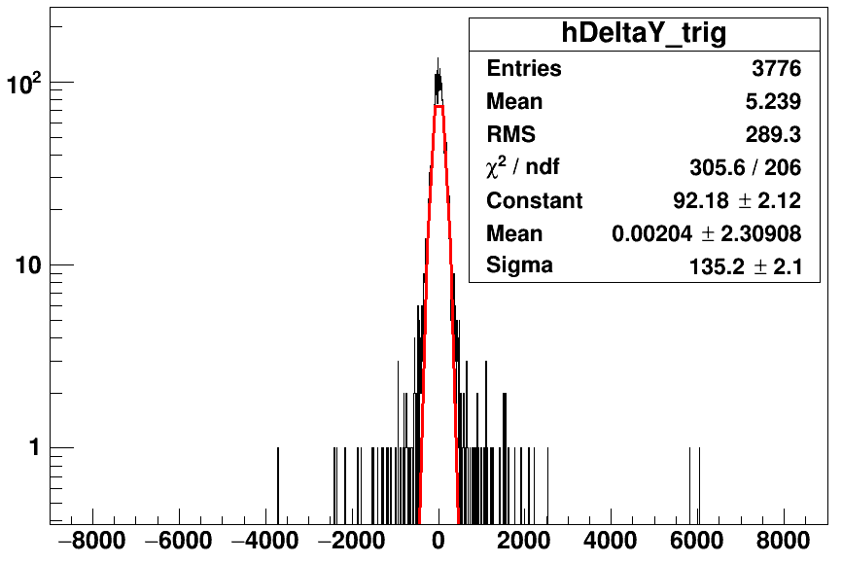
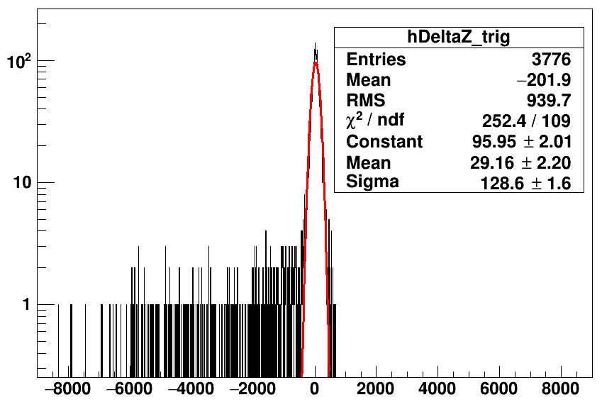
counts
counts
x_{fit} - x_{mc} [mm]
y_{fit} - y_{mc} [mm]
counts
Tl208 partialFill without cuts
z_{fit} - z_{mc} [mm]

Slide 29
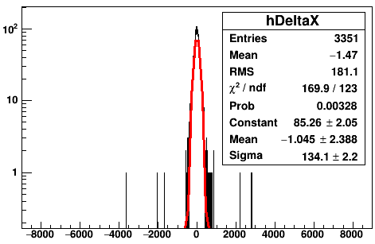
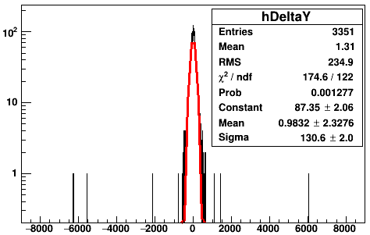
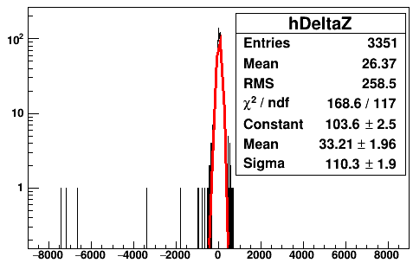
counts
counts
skyShine>1.7
skyShine>1.7
x_{fit} - x_{mc} [mm]
y_{fit} - y_{mc} [mm]
counts
skyShine>1.7
z_{fit} - z_{mc} [mm]

Slide 30
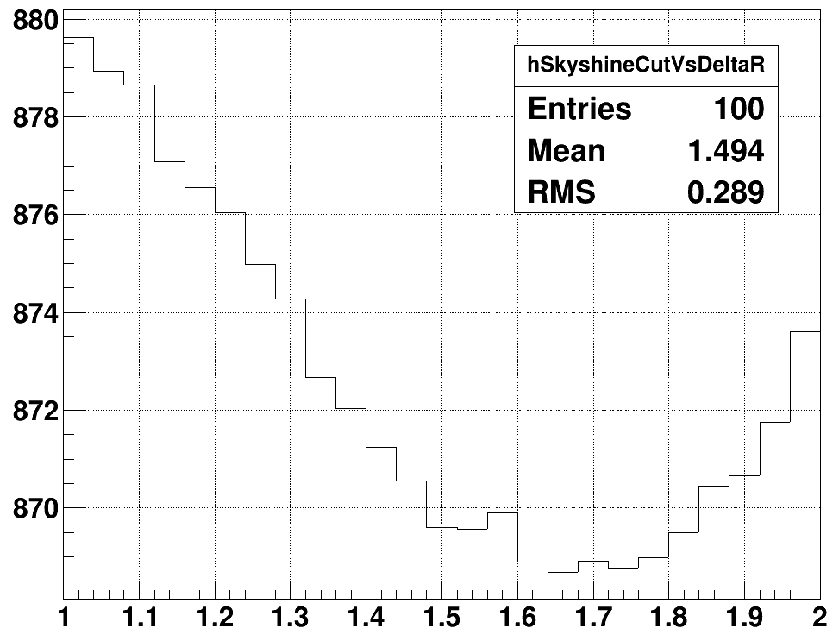
ΔR [mm]
1.65 (minimum)
1.75
skyShine

Slide 31
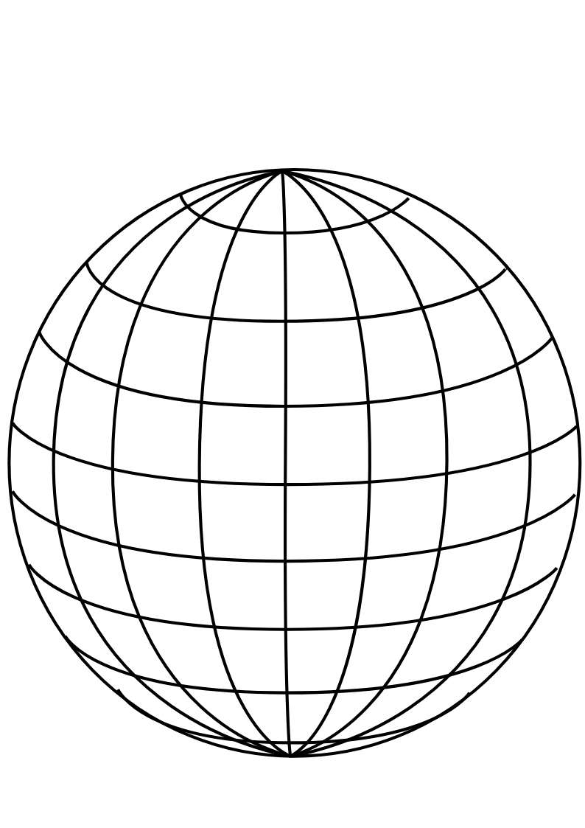
PMT
panel
Uniform Selector
PMT sphere
http://www.downloadclipart.net/download/5816/big-blue-wire-globe-svg

Slide 32
tuning group velocity
PMT hits
Cherenkov
cone
u
PMT sphere
actual event position
pulled event position

Slide 33
drive correction
early hits
late hits
Cherenkov
cone
u
PMT sphere
pulled event position
actual event position

Slide 34
u_{fit}
p₁
X_{fit}
X_{cor}
p₀
O
PMT sphere

Slide 35
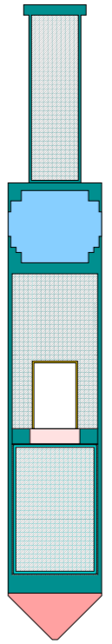
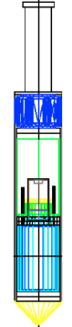
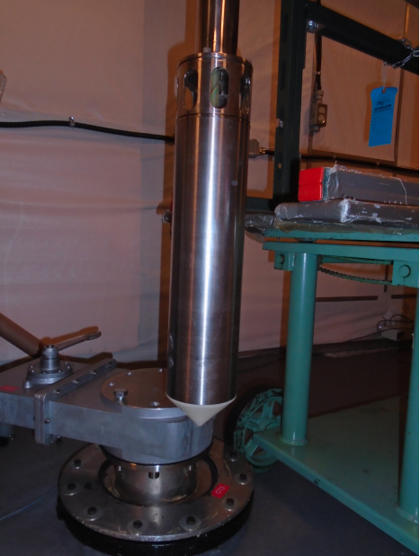
Stainless steel weight cylinder
“Lighthouse” gap, contains
material from scintillator volume
25.3 cm
Stainless steel container
PMT for tagging
Acrylic window
¹⁶N gas decay chamber
Plastic scintillator
Polyethelene bumper cone
5.7 cm

Slide 36
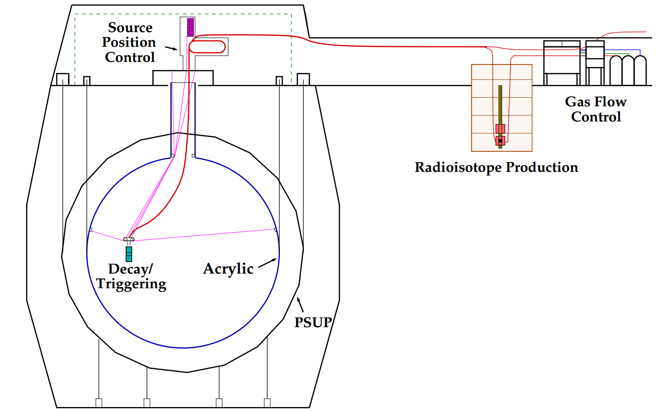
H₂O
H₂O
H₂O
hamer

Slide 37
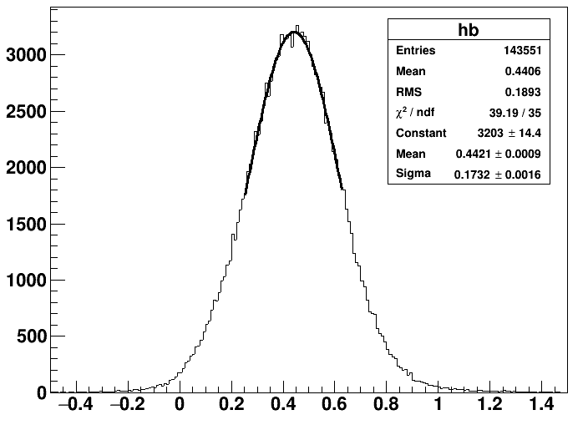
water analysis
fit in 1 sigma

Slide 38
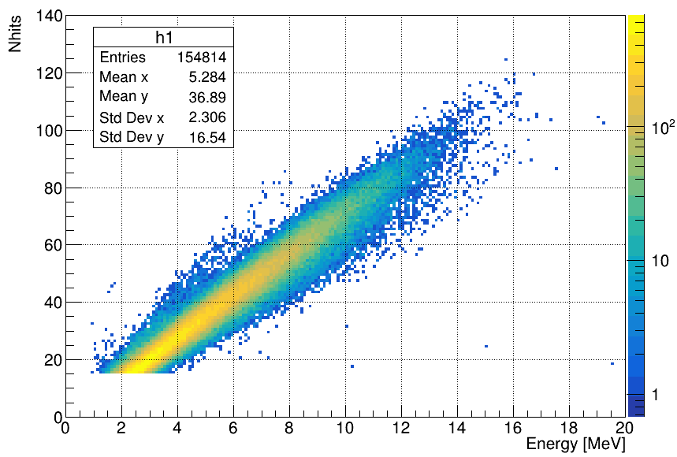
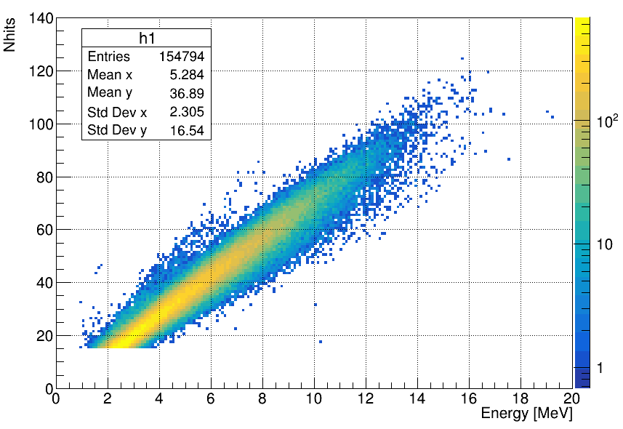
Merged_MPWsolarTest_WaterMP6176_nhit6_GeneralPhysicsMC_WaterSolar_NueRun_r200004to200781.root
T->Draw("nhits:energy>>h","Gtest>0","colz")
Gtest>0
185639/185410
Gtest>0

Slide 39
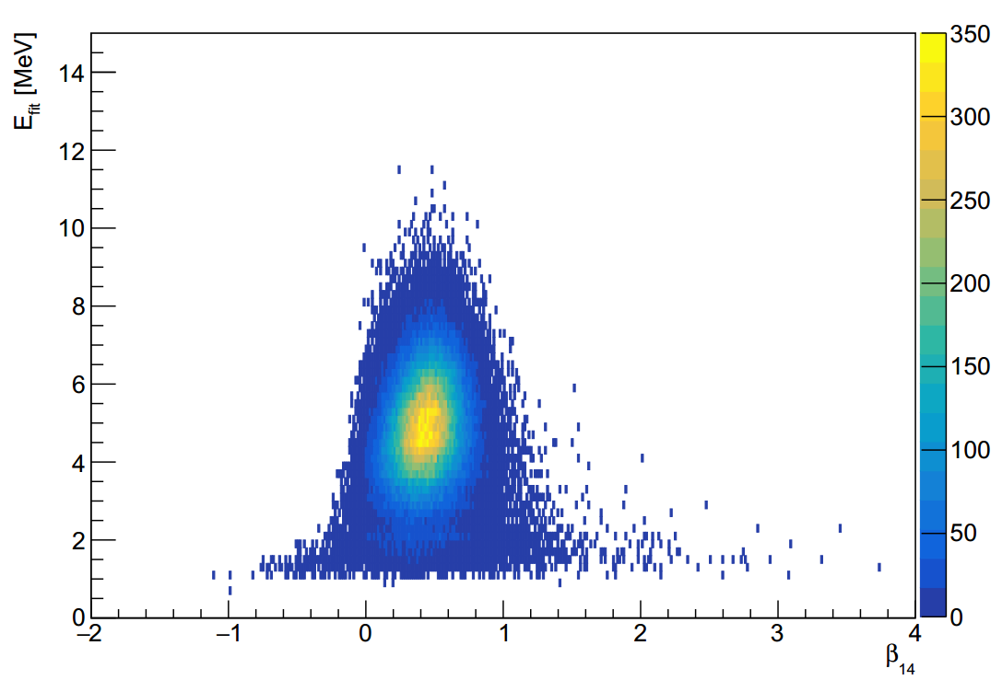

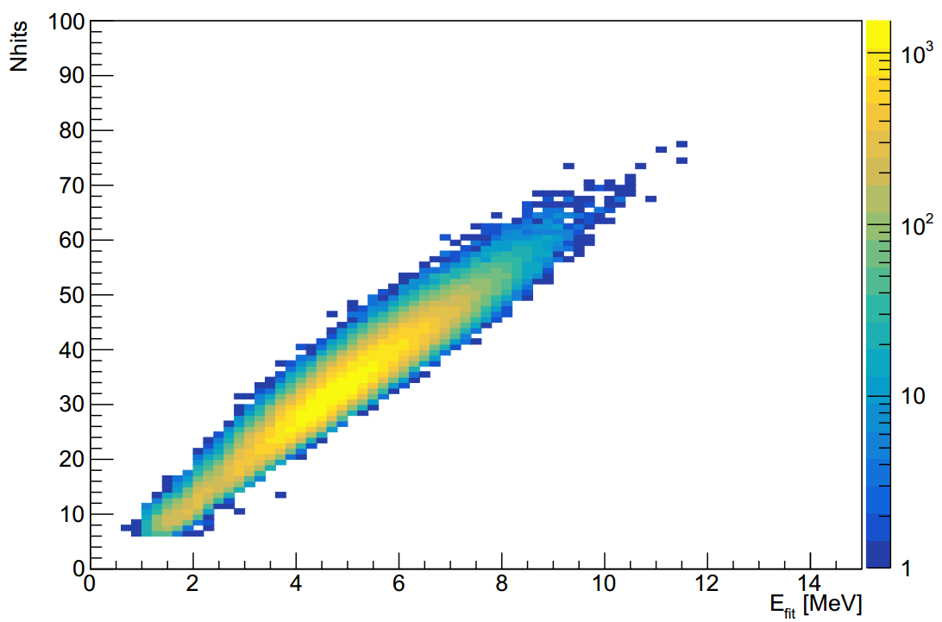
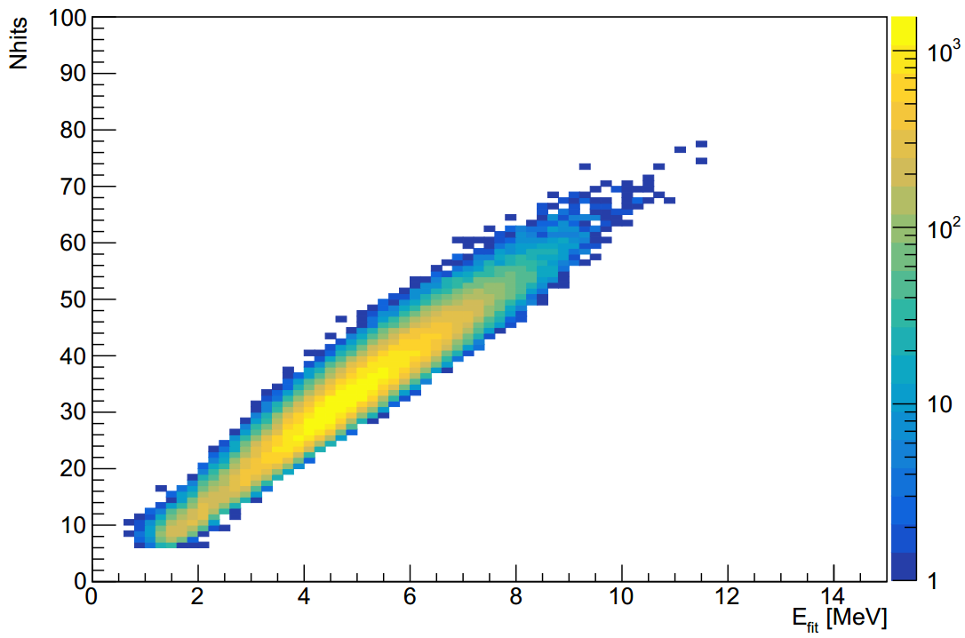
MPW MC
RAT MC
MPW MC
RAT MC

Slide 40
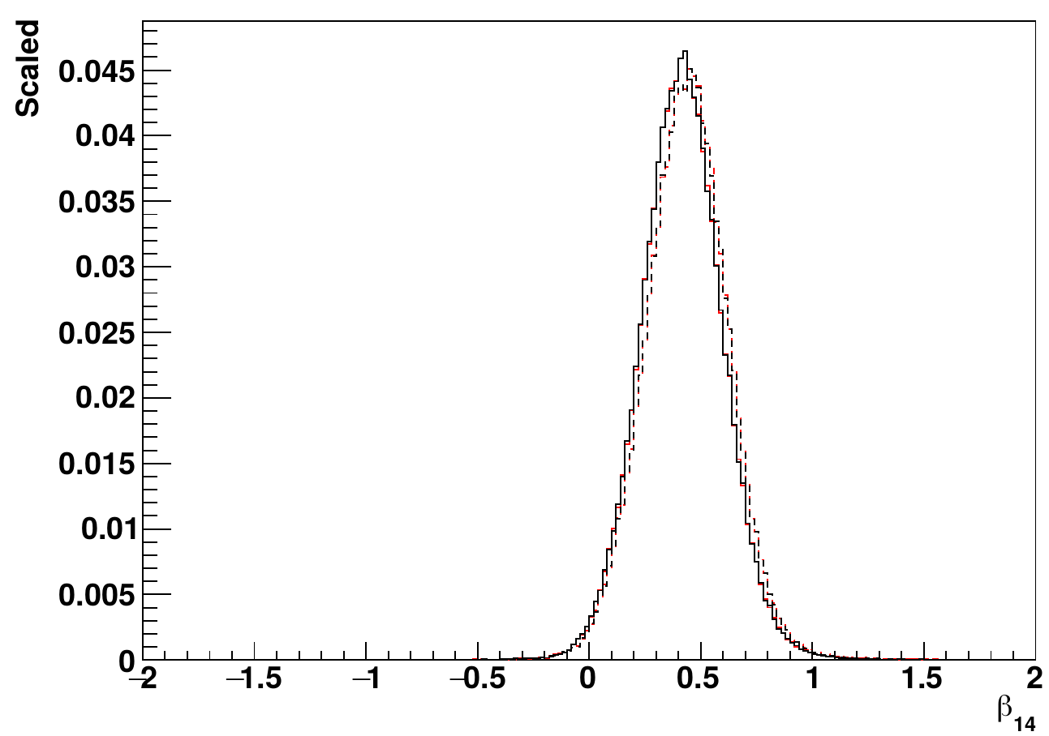
¹⁶N source
central run-107055
— RAT data
— MPW data
--- RAT MC
--- MPW MC

Slide 41
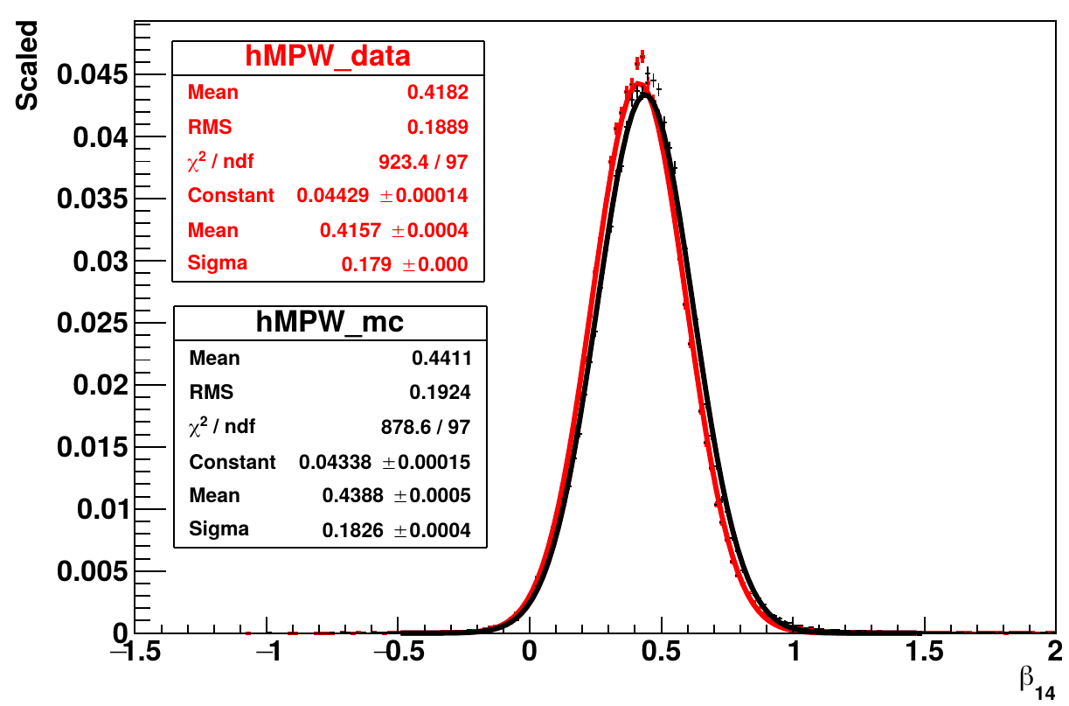
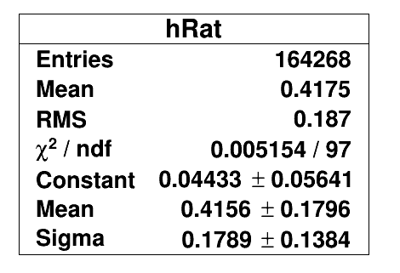
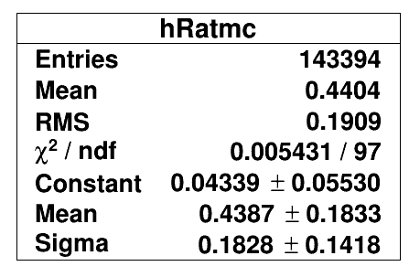
— MPW data
— MPW MC

Slide 42
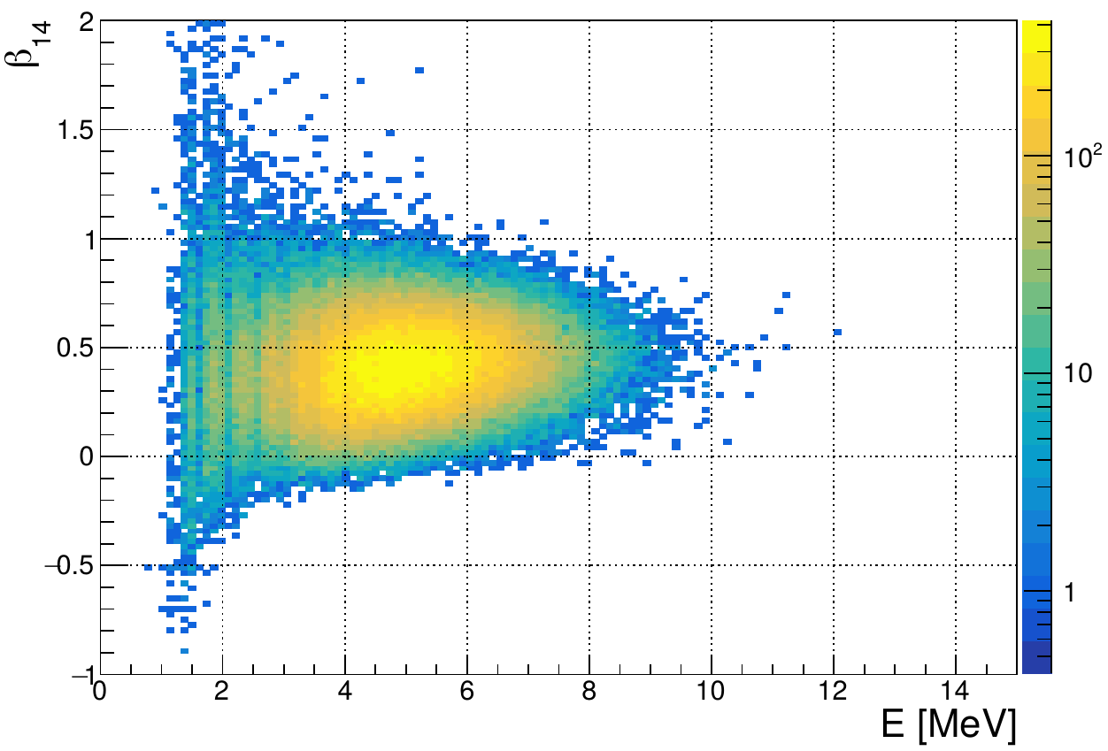
MPW data
107055

Slide 43
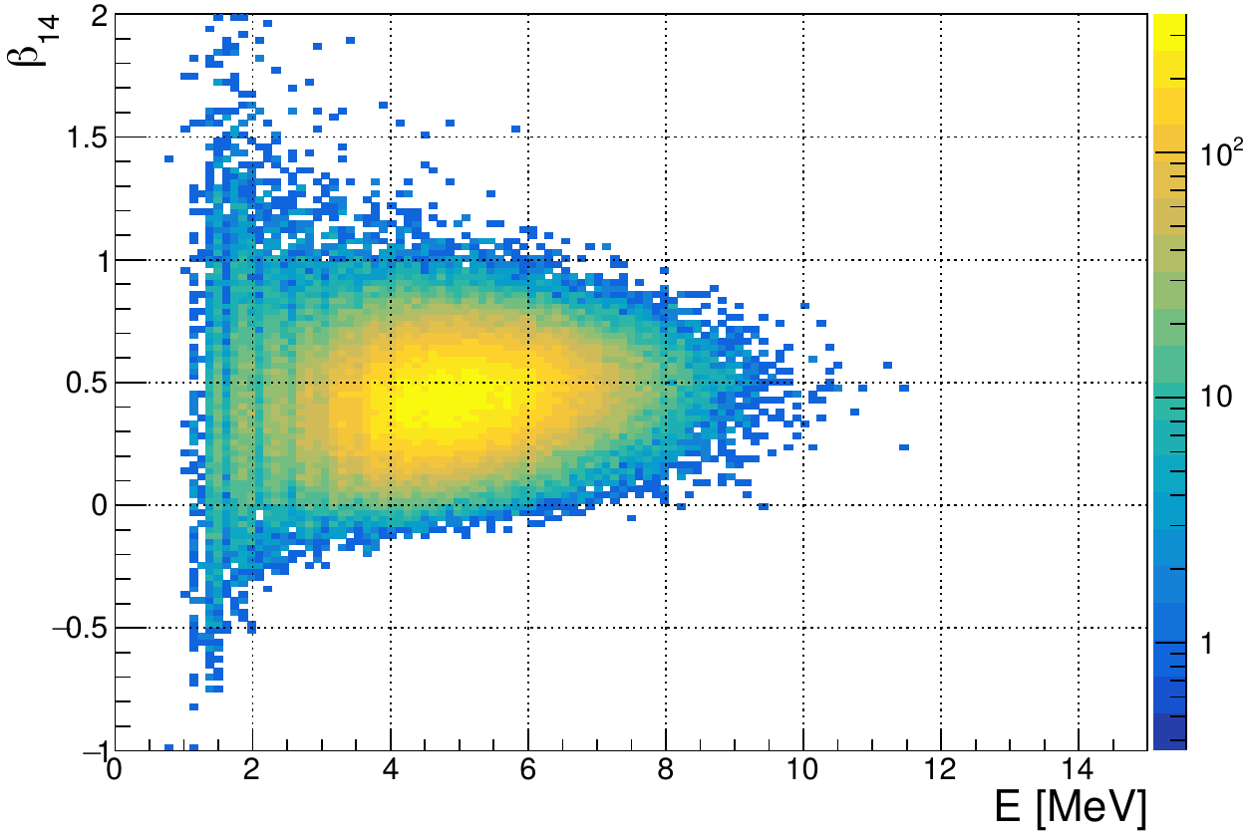
MPW MC
107055

Slide 44
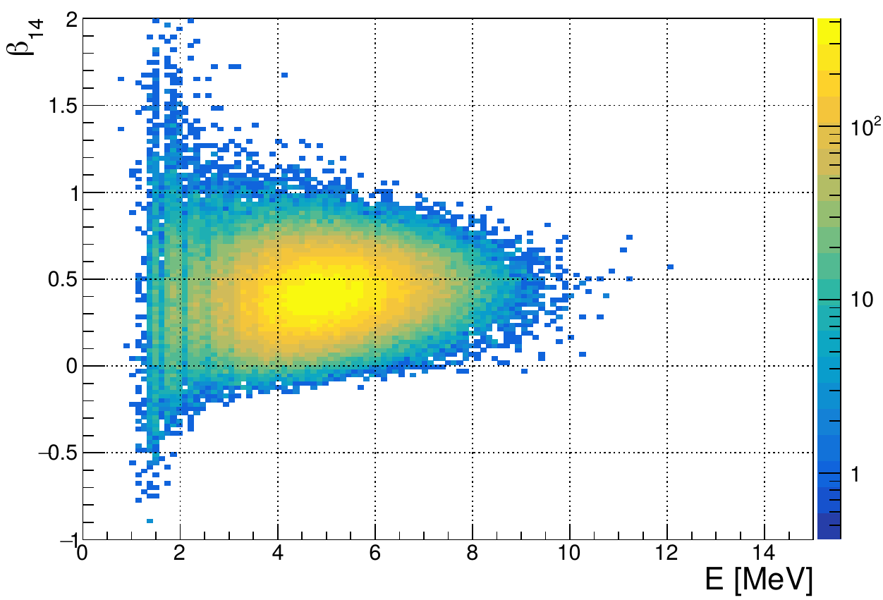
RAT data
107055

Slide 45
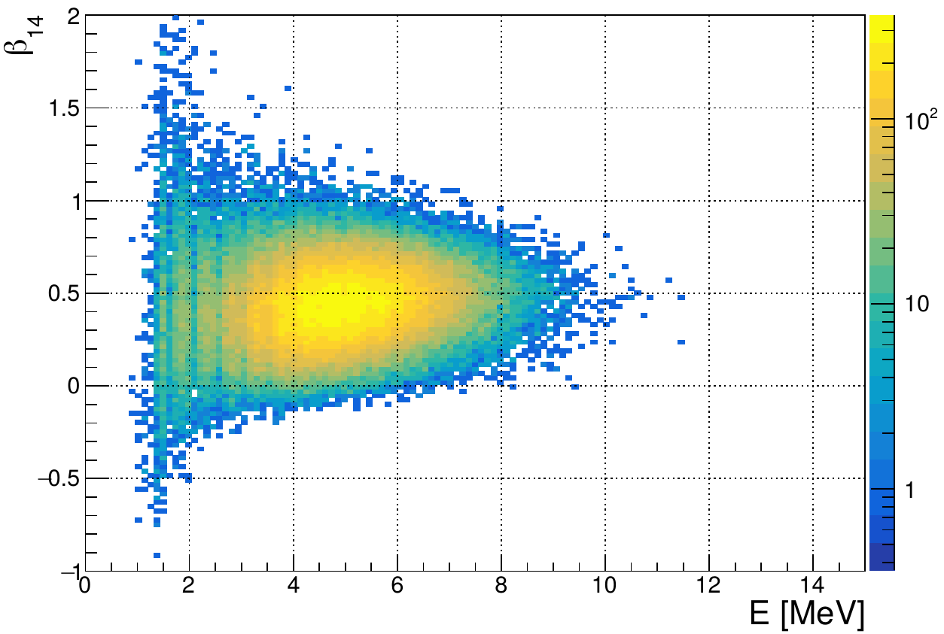
RAT MC
107055

Slide 46
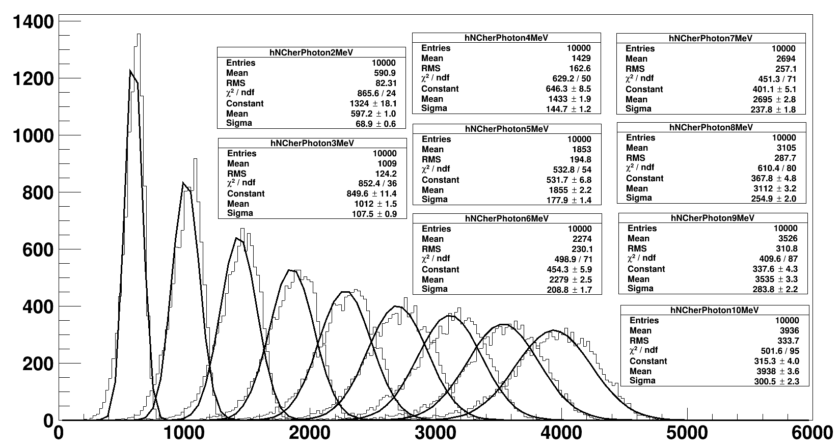


Slide 47


Slide 48


Slide 49


Slide 50


RAT
MPW

Slide 51




111230
Rat MC
111230
MPW MC
MPW
Rat
MPW
Rat

Slide 52

¹⁶N source
central run-107055
— RAT data, uncleaned
— Rat data, cleaned
164268/172408
data clean removes ~4.72% of the events

Slide 53







RAT external solar Nue
MPW external solar Nue
RAT inner solar Nue
MPW inner solar Nue

Slide 54



MPW
scaleLogL<8
RAT
MPW
posRad>6005 && nhits>14
MPW
scaleLogL>12

Slide 55


photoelectric absorption
— Compton scattering
--- pair production

Slide 56
¹⁶N
γ-rays
θ_{PMT}
θ_{e}
X_{true}
e⁻
X_{fit}
PMT

Slide 59

Exwater: solar nu, Tl208, Bi214
²¹⁴Bi
²⁰⁸Tl

Slide 60

¹⁶N source
central run-107055
— RAT data
— MPW data
--- RAT MC
--- MPW MC
NHits

Slide 61

¹⁶N source
central run-107055
— RAT data
— MPW data
--- RAT MC
--- MPW MC

Slide 62

¹⁶N source
central run-107055
r<5.3 m
— RAT data
— MPW data
--- RAT MC
--- MPW MC
¹⁶N source
central run-107055
r<5.3 m
— RAT data
— MPW data
--- RAT MC
--- MPW MC

Slide 63


Slide 64
β₁₄
fitted event position
r_{i}
fitted event direction
θ_{ij}
r_{j}

Slide 65

γ-rays

Slide 66

— 5 MeV
— 4 MeV
— 3 MeV
— 2.5 MeV
— 1 MeV

Slide 67
¹⁶N source
distance
γ-rays
X_{fit}
Compton
scattering
e⁻
θ_{PMT}
PMT

Slide 68


6.17.6
6.5.2
output->Draw("energy>>henergy","waterFit && ( ((dcApplied & 0xFB0000017FFE) & dcFlagged) == (dcApplied & 0xFB0000017FFE) )")

Slide 69

muon induced
10C

Slide 70

10C

Slide 71

11C

Slide 72

11C

Slide 73

6He

Slide 74

6He

Slide 75

Solar phase
11C

Slide 76


Slide 77


Slide 78


Slide 79


Slide 80
stainless steel
container
scintillation vial
PMT #1
PMT #2
plastic piece
stainless steel stand
¹³⁷Cs source
dark box
HV
connector
HV supply
computer
signal/HV
split box
signal/HV
split box
amplifier
amplifier
CAEN
digitizer

Slide 81


scintillation
vial
49.4 mm
14.3 mm
stainless steel
PMT container
plastic holder
30 mm

Slide 82

— LAB-PPO
— TeSOP
— TeDDA
— background

Slide 83

LAB-PPO
multiple p.e.
peak
single p.e.
peak

Slide 85

TeDDA

Slide 86

TeSOP

Slide 87
(a)
(b)
LAB-PPO
TeSOP
single p.e. peak
multiple p.e. peak
(c)
(d)
TeDDA
— LAB-PPO
— TeSOP
— TeDDA
— background

Slide 88
(a)
(b)
LAB-PPO
Te_P1
single p.e. peak
multiple p.e. peak
(c)
(d)
Te_P3
— LAB-PPO
— Te_P1
— Te_P3
— background
This is for publish paper

Slide 89

trigger
trigger
hold-off
integral
time window
pre-gate
threshold
baseline

Slide 90

zero peak
— LAB-PPO without coincidence cut
— LAB-PPO with coincidence cut
single p.e. peak
threshold for counting
multiple p.e. peak

Slide 91


21 Mar 2019

Slide 92


Slide 93

— ²⁰⁸Tl internal
--- ²⁰⁸Tl AV
— ²¹⁴Bi internal
--- ²¹⁴Bi AV
— solar ν_{e}
Internal background vs solar ν_{e} (FV<5.5 m)

Slide 94

— data
— fit
χ²/ndf = 0.87
counts/0.2 bin
Signal
fitted: 67.1+- 9.2 events
1.04 +- 0.14 event/(day*kiloton)
Background
fitted: 3.4 +- 0.91 events
0.05 +- 0.01 event/(day*kiloton)
cosθ_{sun}

Slide 95

counts/0.05 bin
cosθ_{sun}

Slide 96

¹⁶N central run-107055 data
0.61<U<0.95 suggested by the
collaboration
Remove 0.34% events

Slide 97

¹⁶N central run-107055 MC
0.61<U<0.95 suggested by the
collaboration
Remove 0.38% events

Slide 98

¹⁶N central run-107055 data
0<G<1.9 suggested by the
collaboration
Remove 0.01% events

Slide 99

¹⁶N central run-107055 MC
0<G<1.9 suggested by the
collaboration
Remove 0.01% events

Slide 100

¹⁶N central run-107055 data
-11<Z’<1 suggested by the
collaboration
Remove 0.13% events
total 0.37% events

Slide 101

¹⁶N central run-107055 MC
-11<Z’<1 suggested by the
collaboration
Remove 0.13% events
total 0.4% events

Slide 102
— ²⁰⁸Tl internal
--- ²⁰⁸Tl AV
— ²¹⁴Bi internal
--- ²¹⁴Bi AV
— solar ν_{e}

Slide 103


MLP
4<E<15 MeV
MLP
4<E<5 MeV

Slide 104

BDT
4<E<15 MeV

Slide 105

Fisher
4<E<15 MeV

Slide 106

LD
4<E<15 MeV

Slide 107

BDT
4<E_{fit}<15 MeV

Slide 108

MLP
4<E_{fit}<15 MeV

Slide 109

BDT
5<E_{fit}<15 MeV

Slide 110

MLP
5<E_{fit}<15 MeV

Slide 111


BDT, hi E

Slide 112


MLP, hi E

